Slide 1
Constitutive relation based coupled Finite Element formulation for Fluid-Structure Interaction Problem in the eulerian framework
Presented by-
Avinash Kumar Pandey
Guided by-
Prof. A.N.Reddy

Slide 2
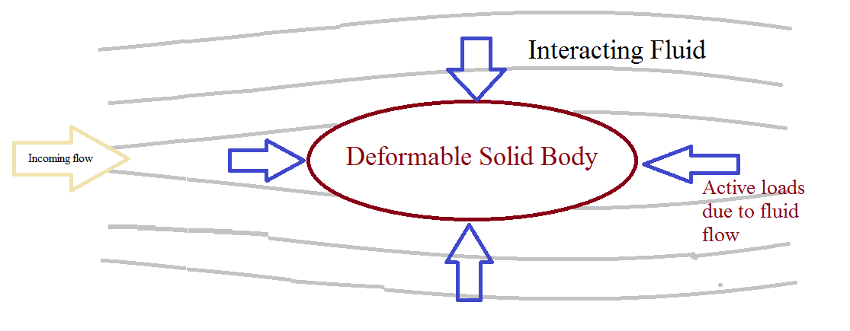
What is FSI?

Slide 3
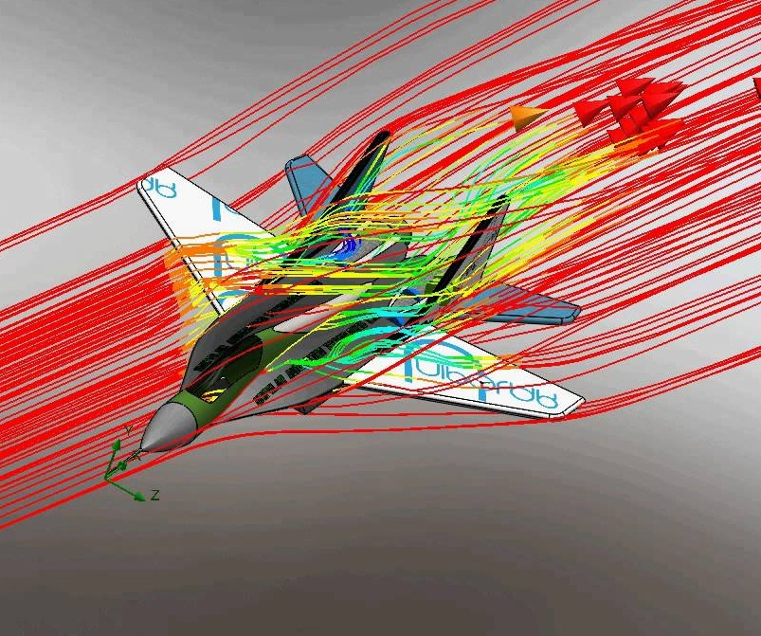
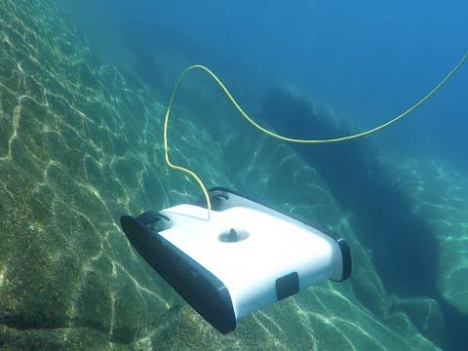
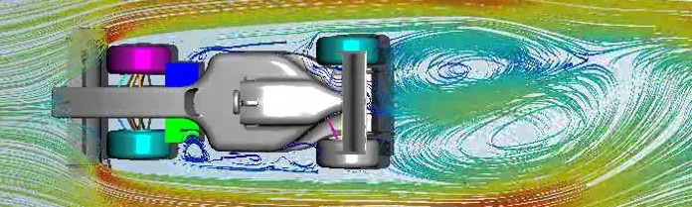
What’s the need?
Engineering

Slide 4
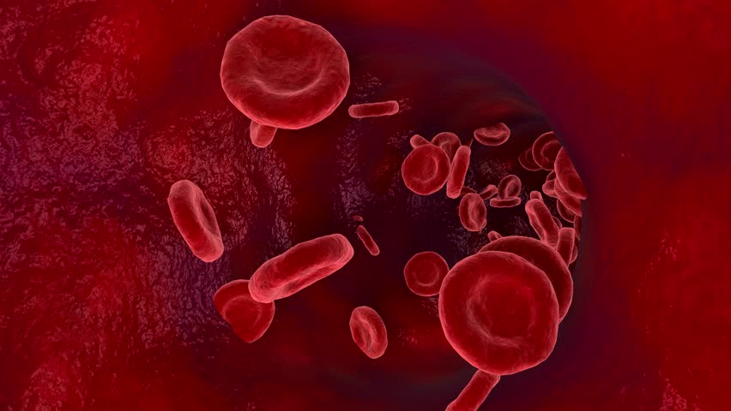
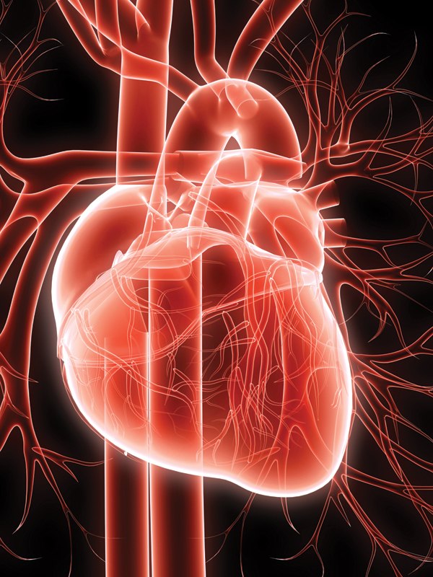
Applications in Biomechanics…

Slide 5
Emphasis
Project Report = What???
Presentation = How???

Slide 6
Literature Review(Important Works)
Brown (1997), Cebral and Lohner (1997a,b) transferred the structural to the fluid surface mesh point
Brown(1997) used interpolation techniques to connect the non-connected points still on interface
Cebral and Lohner (1997a) developed a conservative load projection method
Wood et al. (2010) showed the unstablity of FSI solution in the absence of sub-iteration
Farhat et al. (2006) proposed two different algorithms with second-order temporal accuracy
Zhang et al. (2007) investigated the accuracy, stability and efficiency of two proposed algorithms
Layton 2009,Leveque and Li 1997, Li 2003, Li and Ito 2006, Li and Lai 2001; Tan, Lim and Khoo 2009,Xu and Wang 2008- Immersed interface method
Fadlun et al. 2000, Guy and Hartenstine2010, Luo et al. 2007, Mohd-Yusof 1999, Mark and van Wachem 2008, Shen and Chan2008- The direct forcing method
Glowinski et al. 1999, 2000, 2001;Patankar 2001, Yu 2005, Yu and Shao 2007- The distributed Lagrange multiplier method

Slide 7
PART : 1
FEM OF SOLIDS

Slide 8


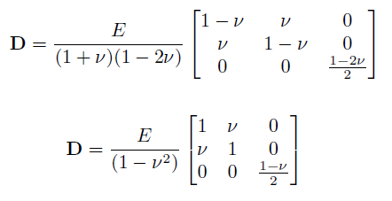

Governing Equation
Constitutive Relation
Plane stress
Plane strain
Strain Displacement Relation

Slide 9
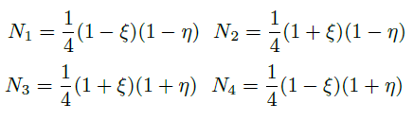
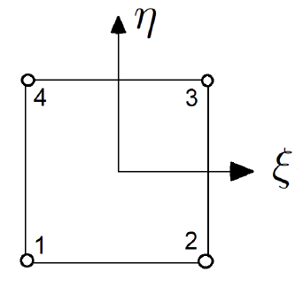
Used FEM
Mapping and Shape Functions: Isoparametric
Element type: 4-node Quadilateral Element

Slide 10
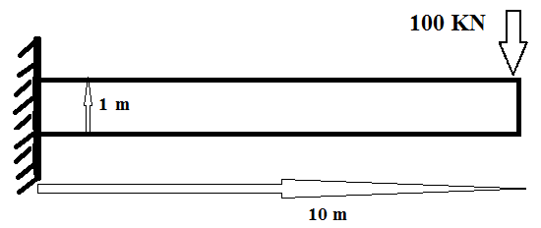
Problem Statement: 1
Why this???
To implement a basic 2D FEM for solids
To develop a basic working code structure in C

Slide 11
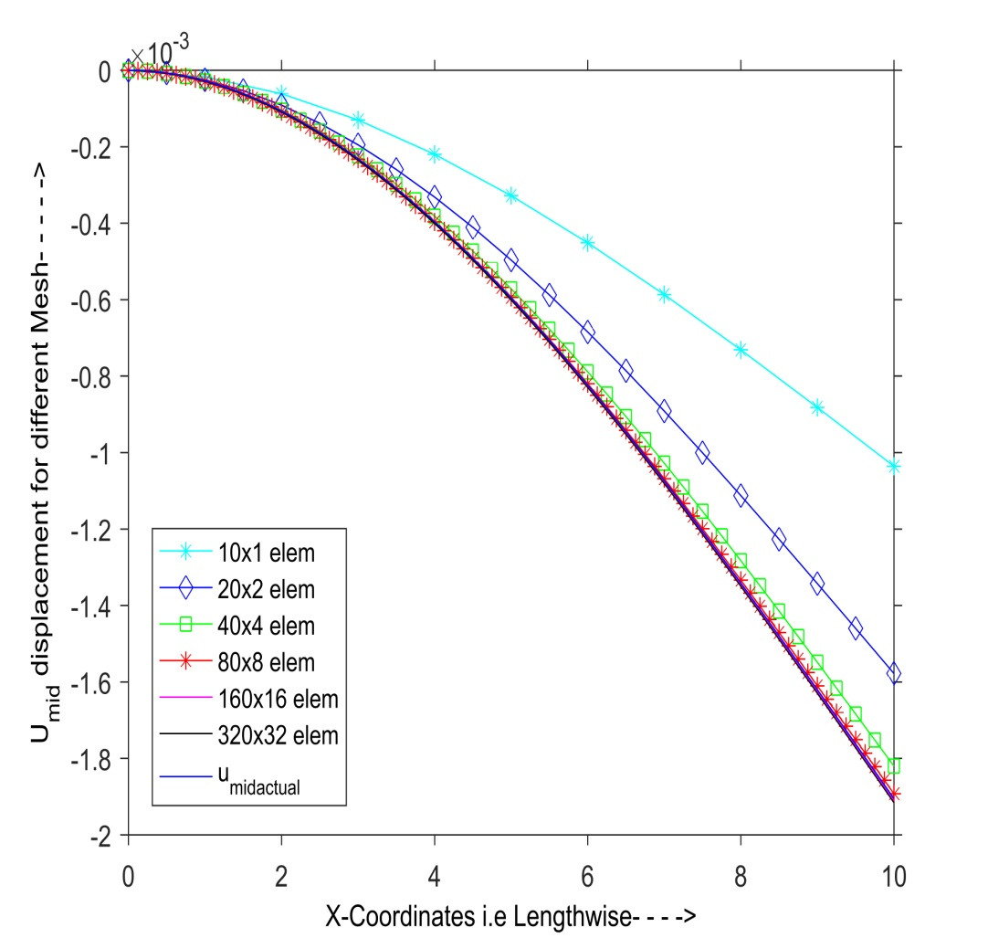
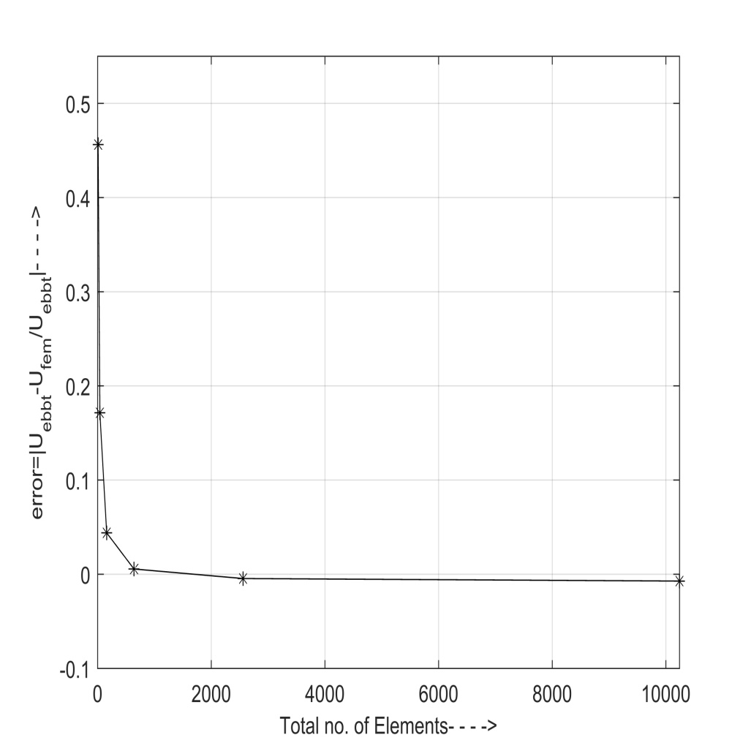
Results
Displacement vs Mesh Error vs no. of elements

Slide 12
PART : 2
FEM OF fluidS

Slide 13





Momentum Conservation
Mass Conservation
Constitutive Relation
Strain Rate velocity relation

Slide 14
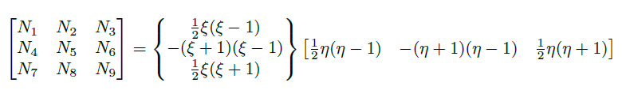
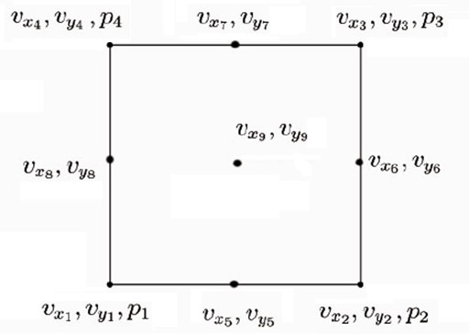
Used FEM
Mapping and Shape Functions: Isoparametric
Element type:
9-node velocity
4-node pressure
Quadilateral element

Slide 15
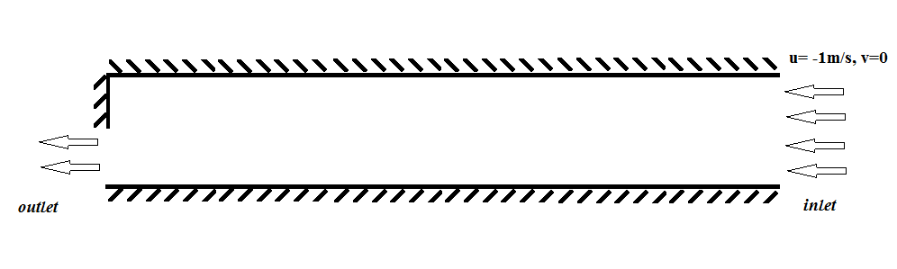
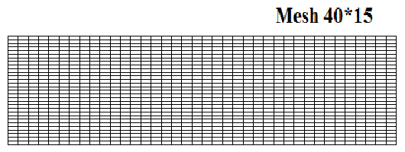
Problem Statement: 2
Flow through sudden contraction(10m*2m channel)- To implement the steady state FEM formulation for incompressible fluids

Slide 16
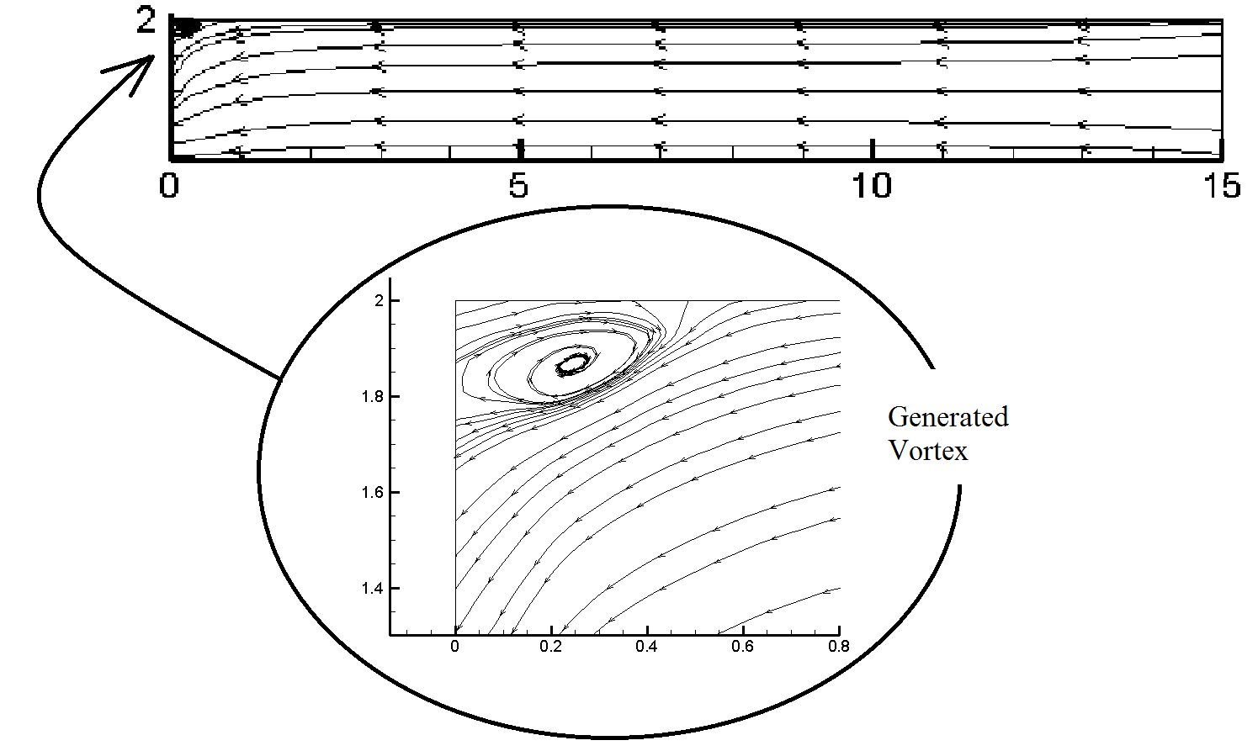
Results
Streamlines

Slide 17
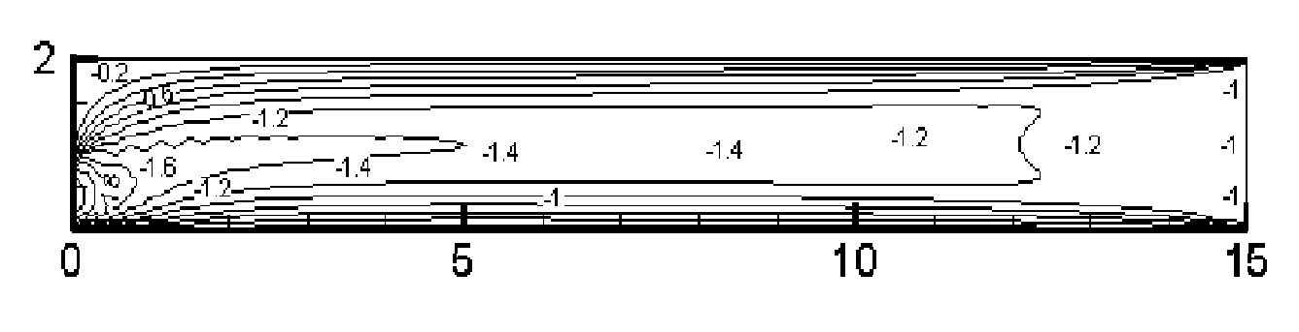
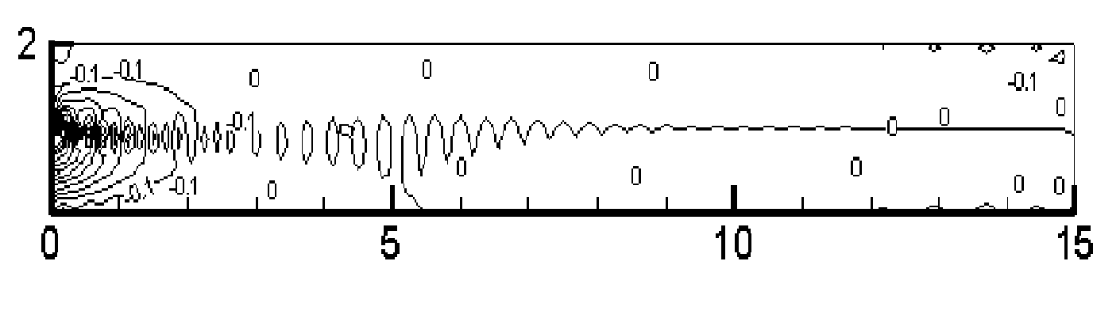
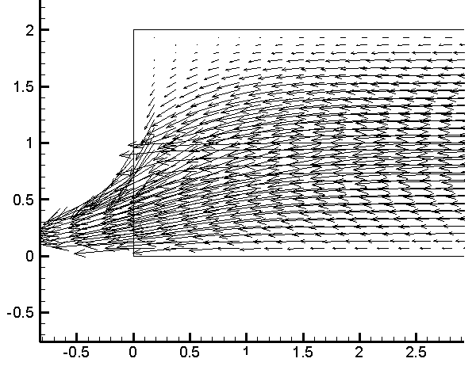
1.u-velocity contour
2.v-velocity contour
3.Vector plot: Outlet

Slide 18
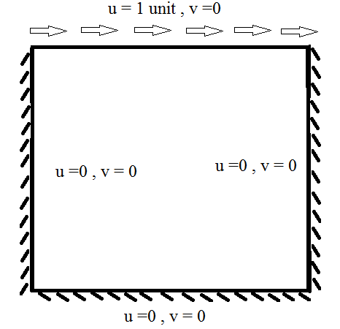
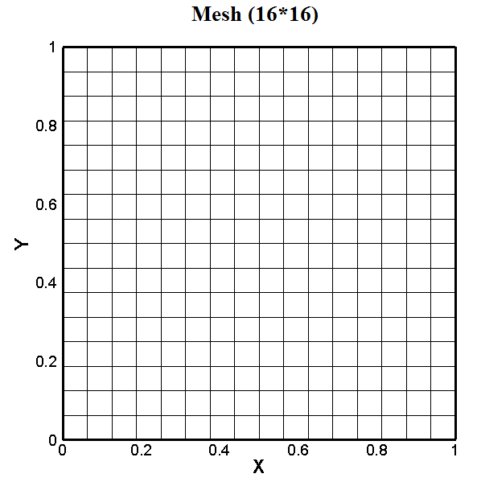
Problem Statement: 3
Lid Driven Cavity- To implement unsteady FEM formulation for incompressible fluids

Slide 19
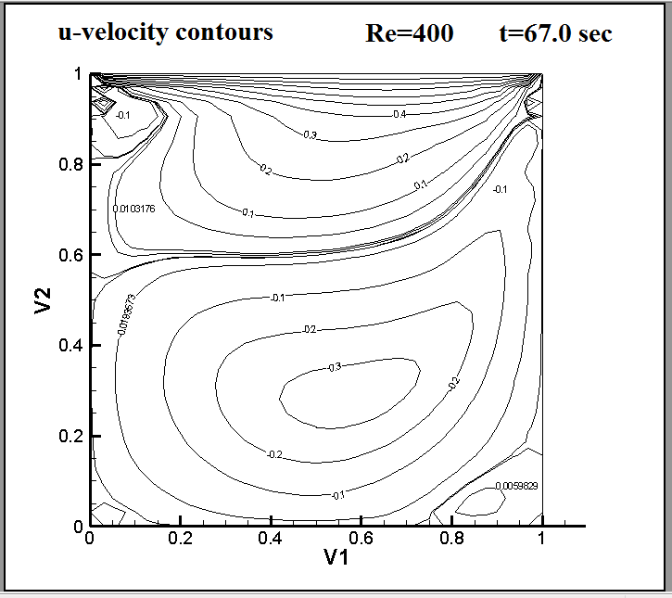
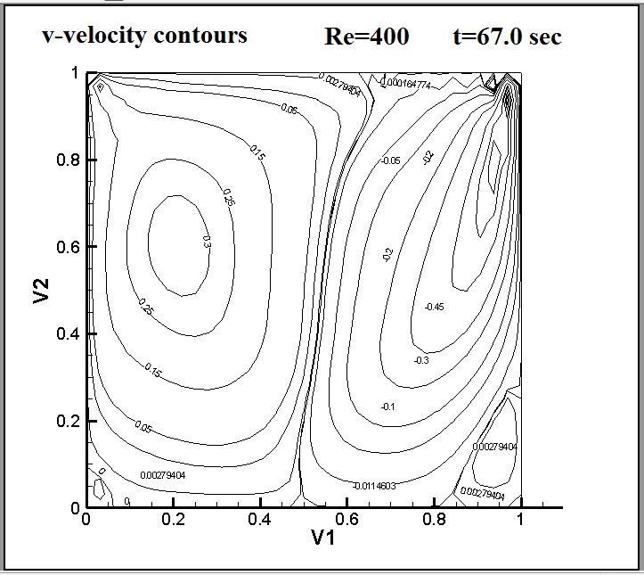
Results

Slide 20
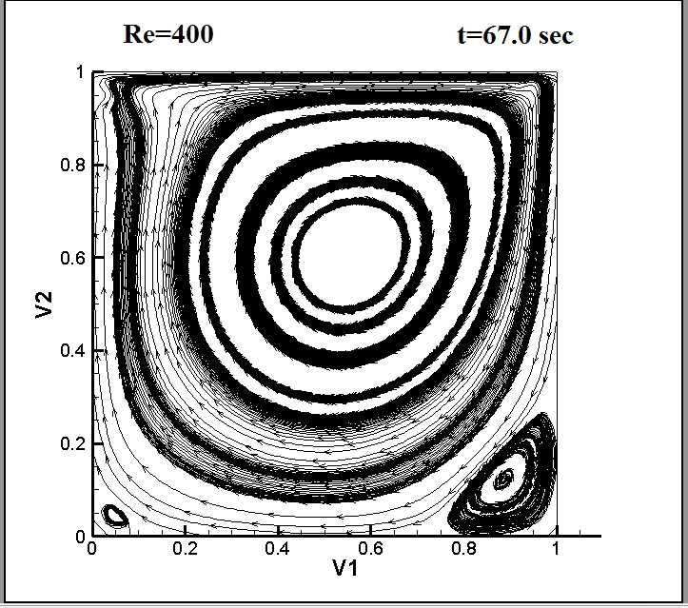
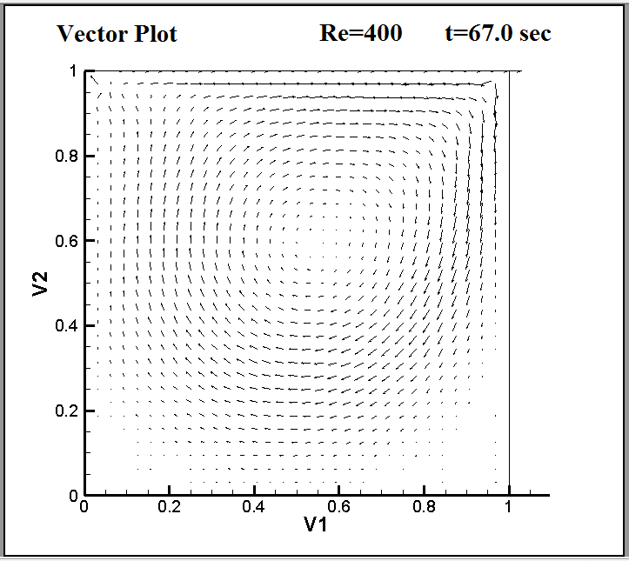

Slide 21
PART : 2
FEM OF fluid- structure interactions

Slide 22
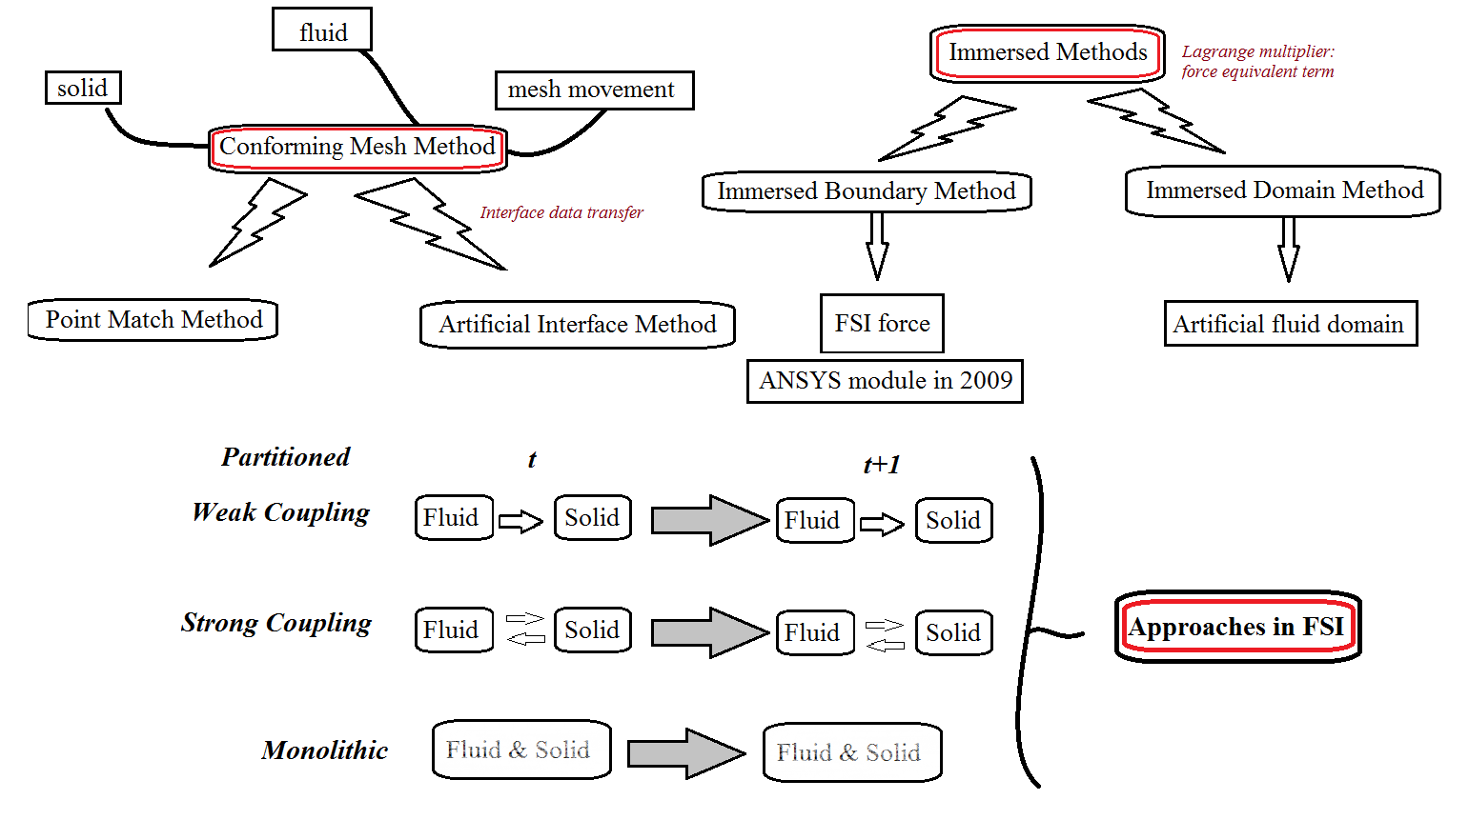
Popular methods until today

Slide 23

IDEA for the Implementation
COUPLING AT CONSTITUTIVE LEVEL BY MEANS OF STRESSES AND DEVELOPING A VISCO ELASTIC ELEMENT

Slide 24


Governing Equations(both solid and fluid treated as a continuum)
Momentum Conservation
Mass Conservation
Velocity Displacement Relation

Slide 25

Constitutive Relations
Fluids (Incompressible)
With strain rate velocity relation as
Solids
(Incompressible) strain displacement relation
for Plane Stress
for Plane Strain

Slide 26
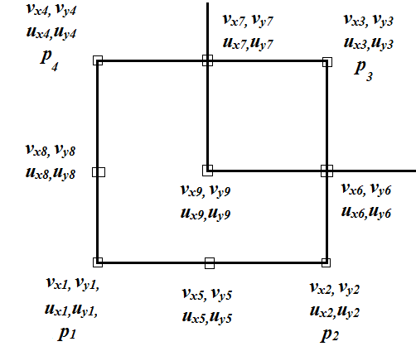
Used FEM
Mapping and shape functions- Isoparametric
Element type:
9-node velocity
9-node displacement
4-node pressure
Quadilateral Element

Slide 27
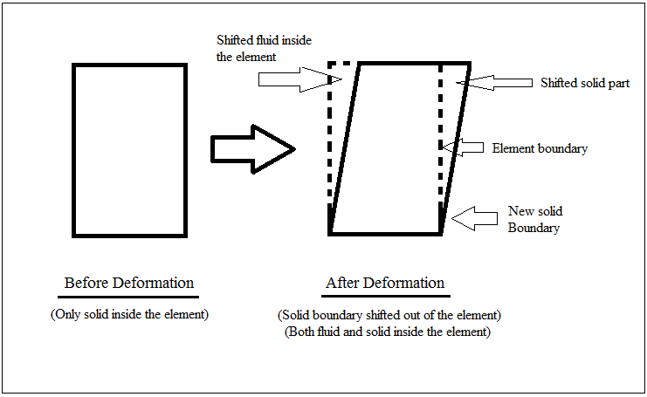
Solid Advection

Slide 28
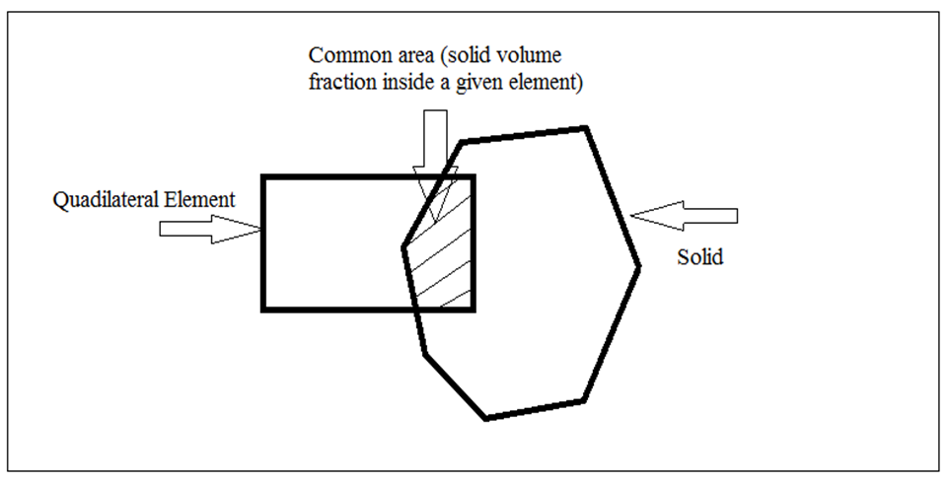
Viscoelastic Element

Slide 29
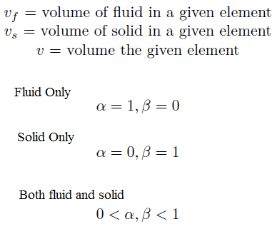
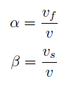

Net Stress of an Element:
Volume Fractions and their variation inside elements:
with-

Slide 30
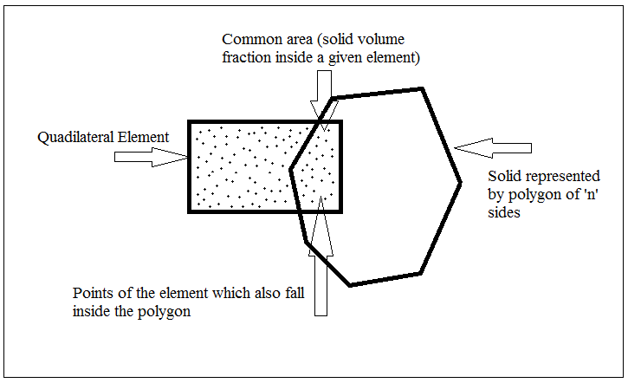
Finding Volume Fractions using Monte Carlo Method

Slide 31
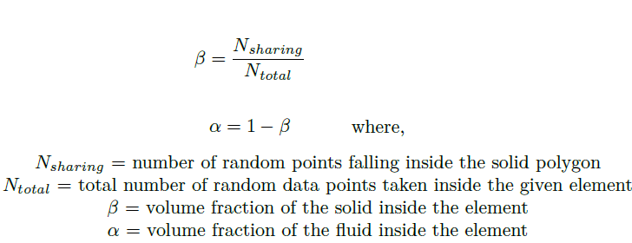
Even – Odd Rule:

Slide 32
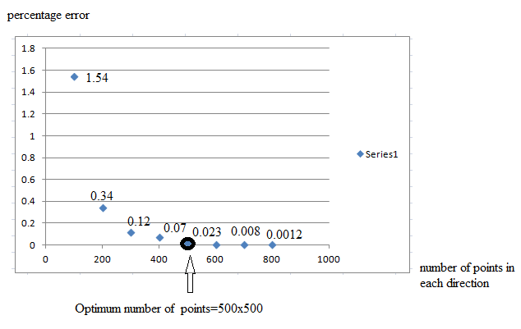
Accuracy analysis of the method

Slide 33
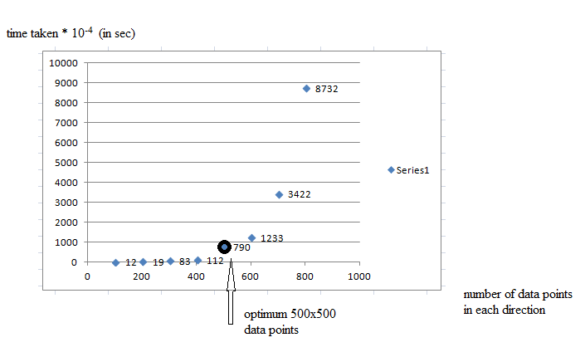
Computation time analysis of method

Slide 34
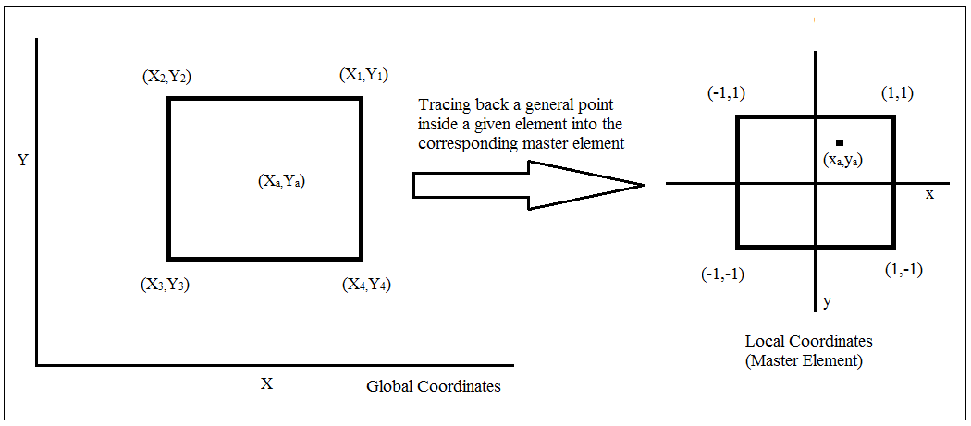
Interpolation of Solid displacements

Slide 35


Relation between the points in the Physical Domain and Computational Domain:
Displacement Interpolation Formula: using FEM:

Slide 36
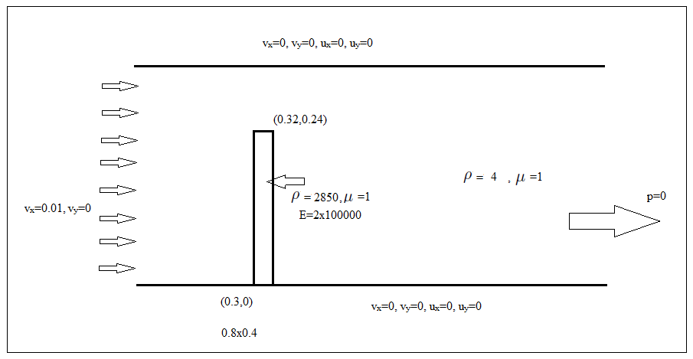
Problem Statement: 4
Flow over a flexible cantilever- To implement the viscoelastic element formulation

Slide 37
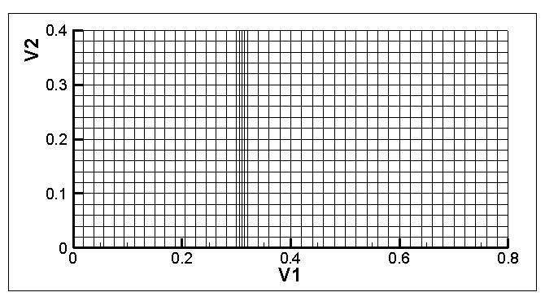
Mesh Used: Structured and Orthogonal

Slide 38
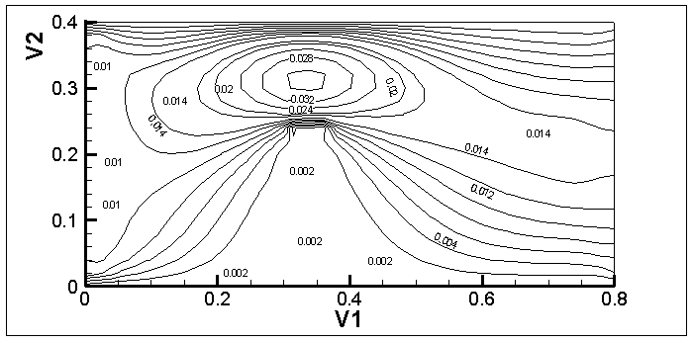
u-velocity contours

Slide 39
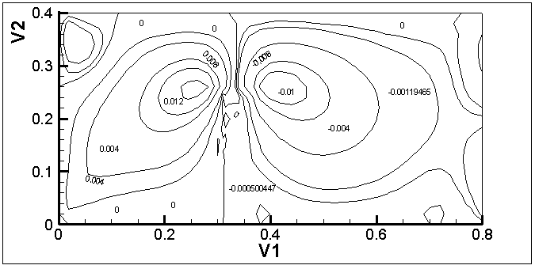
v-velocity contours

Slide 40
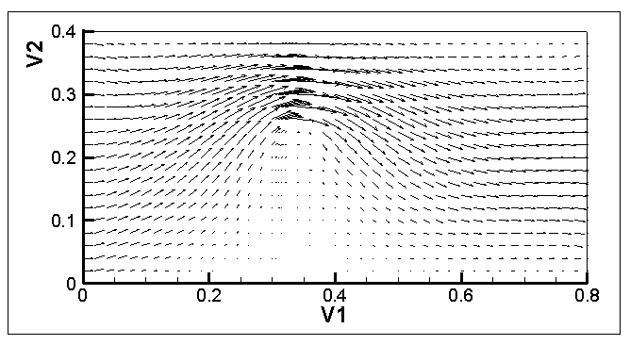
Vectors

Slide 41
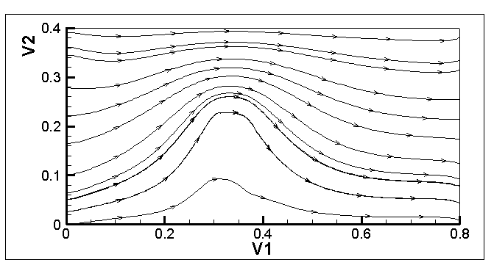
Streamlines

Slide 42
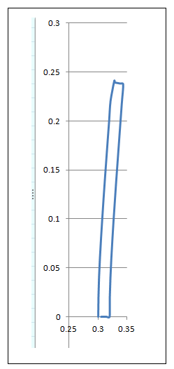
Solid Displacement

Slide 43
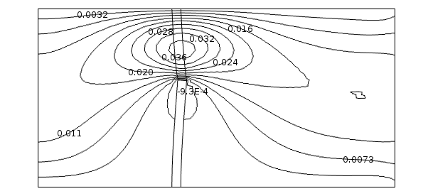
Comparison with COMSOL (u-velocity contours)
COMSOL

Slide 44
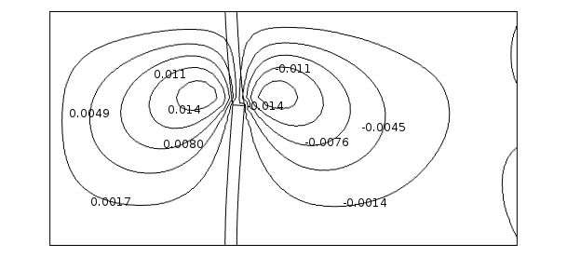
v-velocity contours
COMSOL

Slide 45
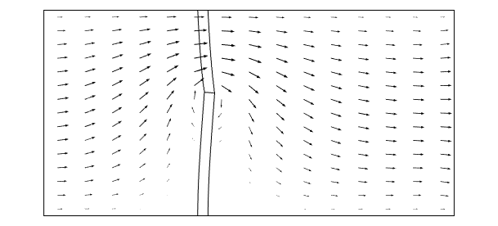
Vectors
COMSOL

Slide 46
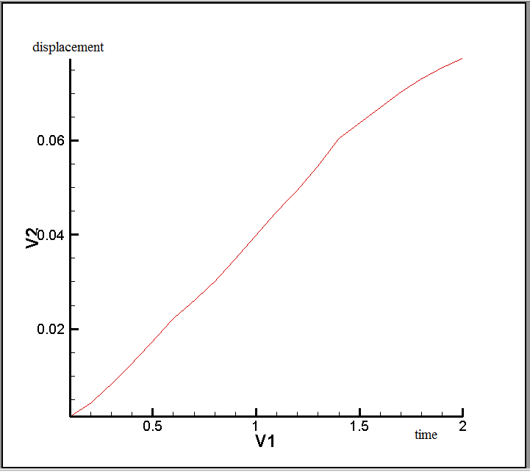
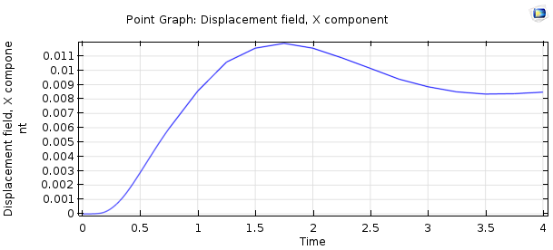
u-velocity comparison at (0.32,0.24)
COMSOL

Slide 47
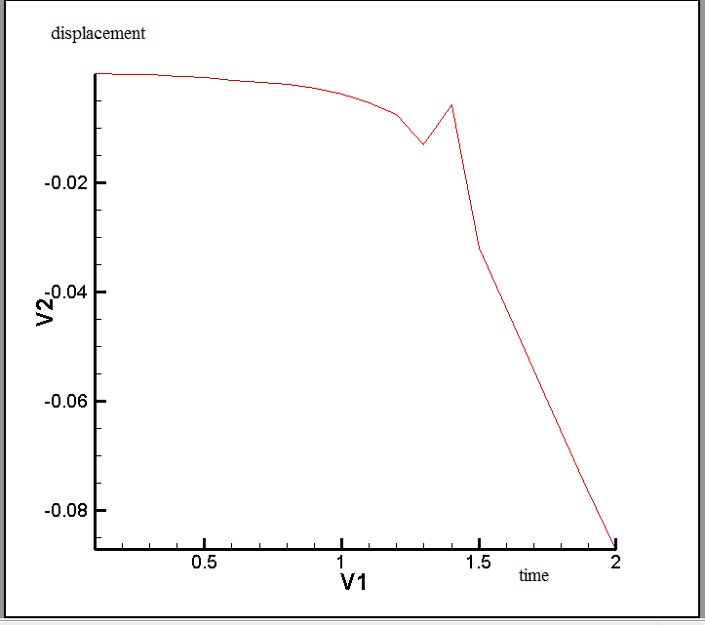

v-velocity comparison at (0.32,0.24)
COMSOL

Slide 48

Problem Statement: 4

Slide 49

Mesh Used: Structured and Orthogonal

Slide 50

u-velocity contours

Slide 51

v-velocity contours

Slide 52

Vectors

Slide 53

Streamlines

Slide 54

Cylinder Displacements

Slide 55

Comparison with COMSOL (u-vel)
COMSOL

Slide 56

v-velocity contours
COMSOL

Slide 57

Vectors
COMSOL

Slide 58


u-displacement vs time at (0.4,0.26)
COMSOL

Slide 59


v-displacement vs time at (0.4,0.26)
COMSOL

Slide 60
Numerical Aspects
Non-linear Solver
Newton’s Method (Implicit)
Linear Solver
Gauss Seidel
Numerical Recipes
LAPACK
BICGSTAB
Dolittle (LU Decomposition)

Slide 61
Tools Used
ANSYS Mechanical APDL- Grid generation
C language (gcc compiler)
o3 optimization in linux
Some basic optimization techniques in C
Matlab
TecPlot 360

Slide 62
Coupling at Constitutive level and treating both solid and fluid as a continuum
Kazuyasu Sugiyama et al. : Journal of Computational Physics 230 (2011) 596-627
Transport of Left Cauchy Deformation for solid advection
Boris Valkov et al. : 2015
Solid advection by transporting deformation gradient
in the reference map

Slide 63

Conclusions

Slide 64

Future Scope

Slide 65
Thank You

